Slide 1
MmWave Radar Point Cloud Segmentation using GMM in Multimodal Traffic Monitoring
Feng Jin
March 30, 2020

Slide 2
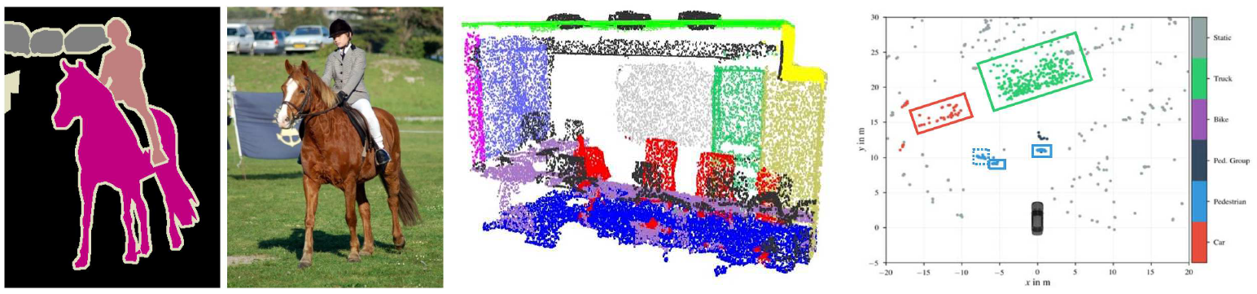
Segmentation
Unsupervised approaches:
GMM, k-means, SVM, …
Unsupervised approaches:
ISODATA, k-means,…
Supervised approaches:
Voxelization then CNN,
PointNets
Supervised approaches:
Fully convolutional network (FCN),
Regions with CNN (R-CNN), …
Supervised approaches:
PointNets, DBSCAN+LSTM

Slide 3
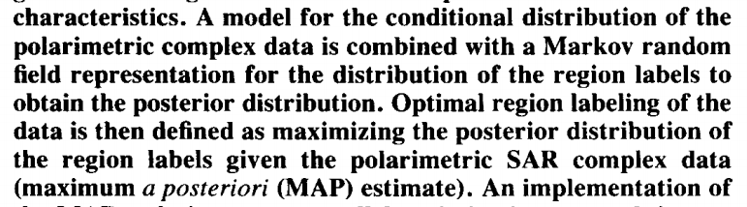
SAR Image Segmentation [1]
[1] Rignot, Eric, and Rama Chellappa. "Segmentation of polarimetric synthetic aperture radar data." IEEE Transactions on Image Processing 1.3 (1992): 281-300.

Slide 4
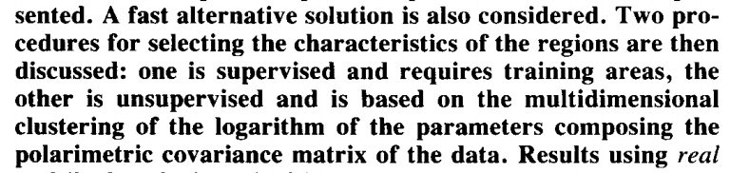
SAR Image Segmentation [1]
[1] Rignot, Eric, and Rama Chellappa. "Segmentation of polarimetric synthetic aperture radar data." IEEE Transactions on Image Processing 1.3 (1992): 281-300.

Slide 5
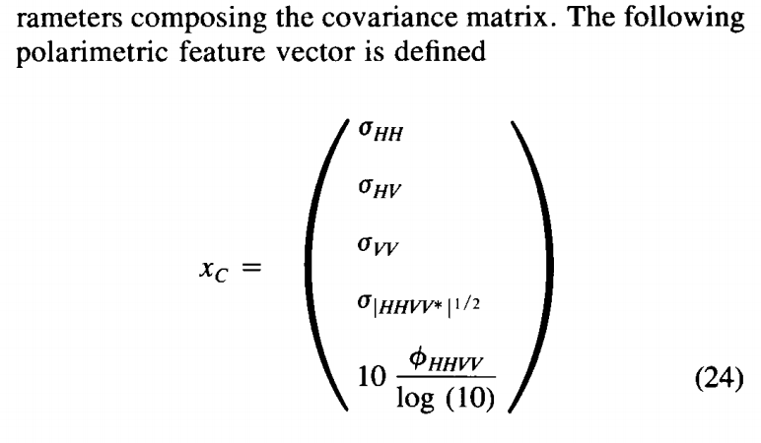
SAR Image Segmentation [1]
A polarimetric model with Markov random
Supervised:
MAP classifier
max p(u|x)
The ISODATA algorithm is similar to the k-means algorithm with the distinct difference that the ISODATA algorithm allows for different number of clusters while the k-means assumes that the number of clusters is known a priori.
Supervised:
MAP classifier
Unsupervised: ISODATA
[1] Rignot, Eric, and Rama Chellappa. "Segmentation of polarimetric synthetic aperture radar data." IEEE Transactions on Image Processing 1.3 (1992): 281-300.

Slide 6
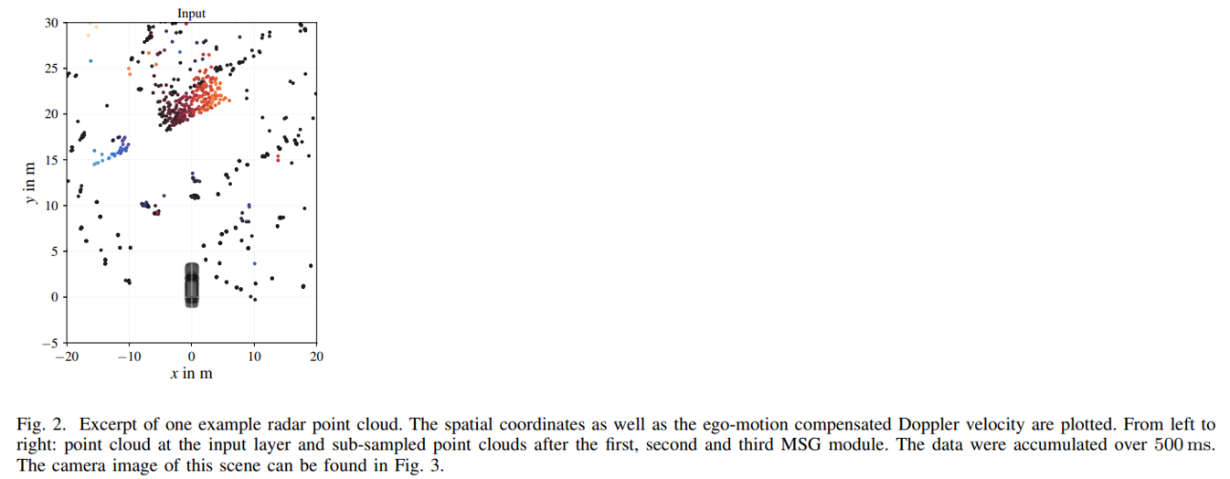
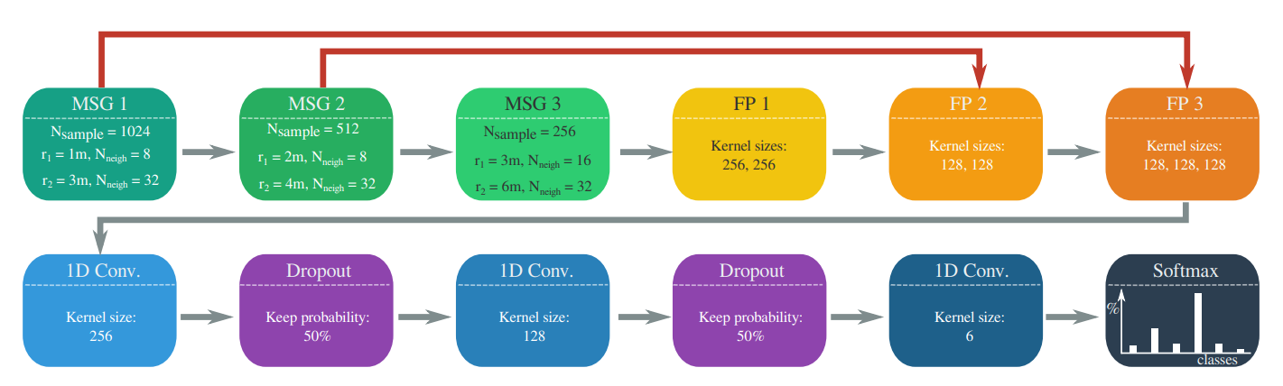
Radar Point Cloud Segmentation [2]
A work from Daimler research center
Data accumulation problem:
40 Mph=17 m/s
Move 8 meters during 0.5 seconds
PointNets
[2] Schumann, Ole, et al. "Semantic segmentation on radar point clouds." 2018 21st International Conference on Information Fusion (FUSION). IEEE, 2018.

Slide 7
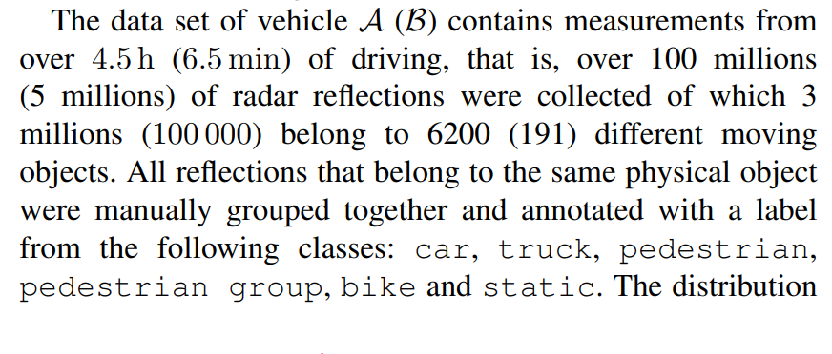
Radar Point Cloud Segmentation [2]
[2] Schumann, Ole, et al. "Semantic segmentation on radar point clouds." 2018 21st International Conference on Information Fusion (FUSION). IEEE, 2018.

Slide 8
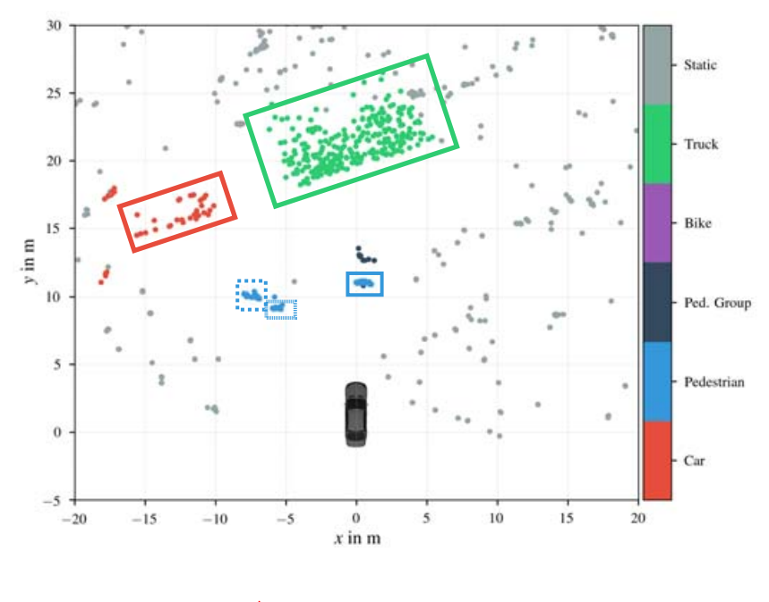
Radar Point Cloud Segmentation [2]
[2] Schumann, Ole, et al. "Semantic segmentation on radar point clouds." 2018 21st International Conference on Information Fusion (FUSION). IEEE, 2018.

Slide 9
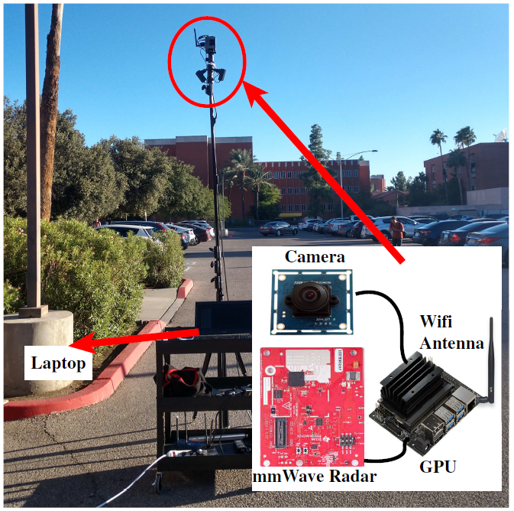
Our work - Hardware

Slide 10
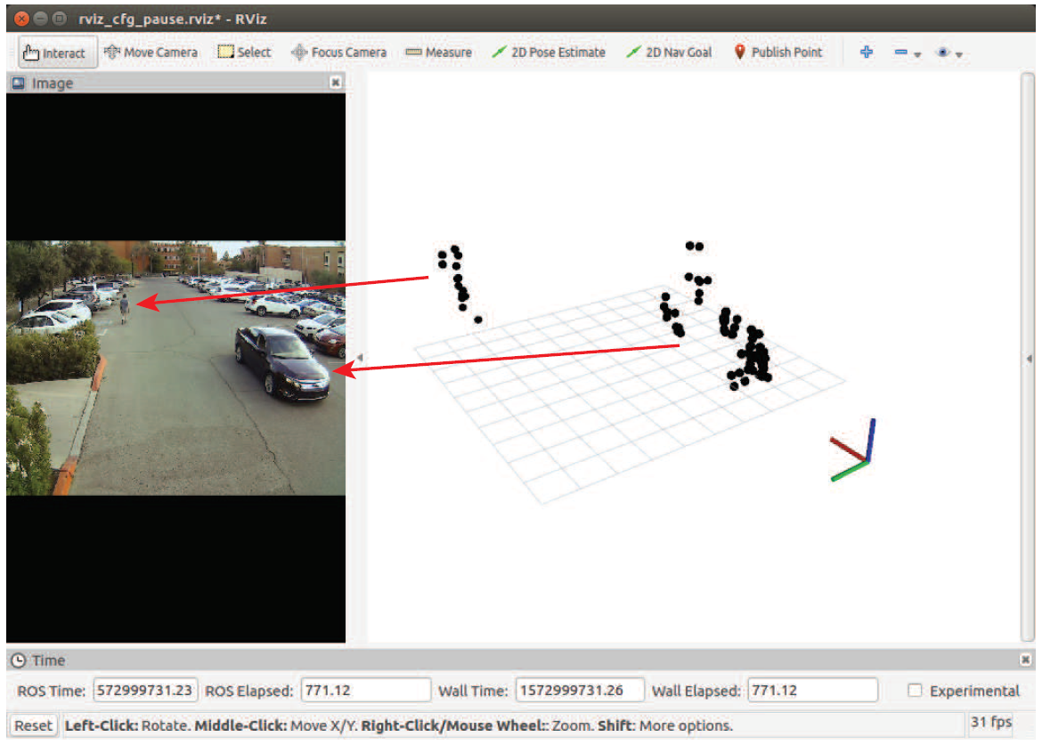
Our work – Data Collection

Slide 11
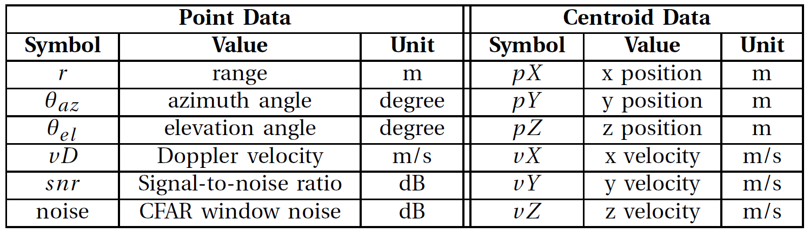
Our work – Radar Data

Slide 12
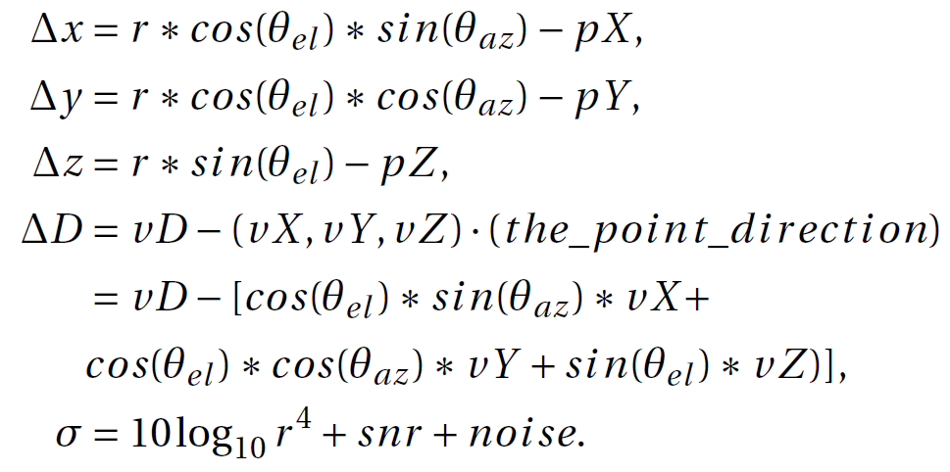
Our work – Feature Vector
Body extent
Relative Doppler
RCS

Slide 13
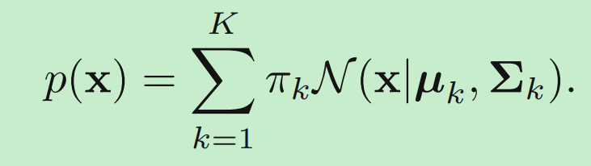
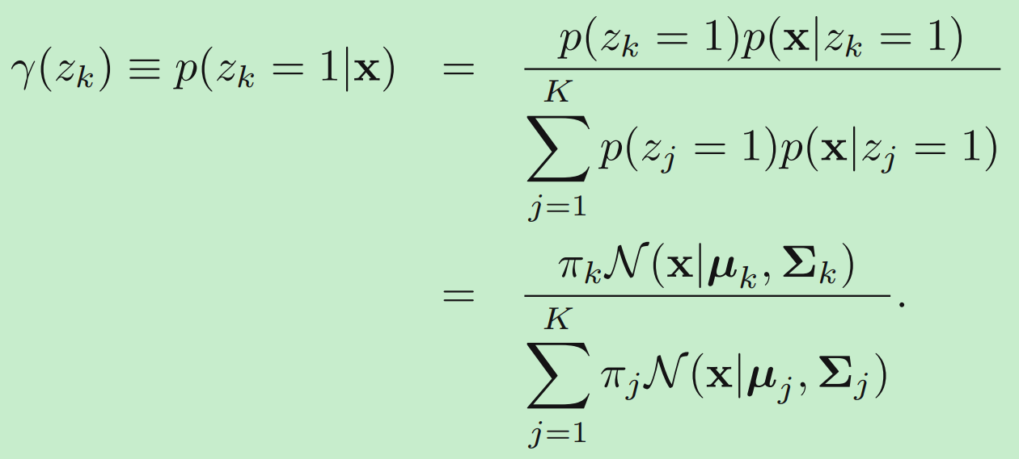
Our work – Gaussian Mixture Model (GMM)
GMM
Maximize a posterior (MAP)
posterior
Which class?
How to estimate these parameters?

Slide 14
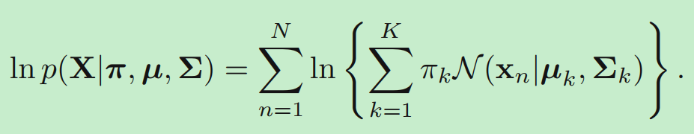
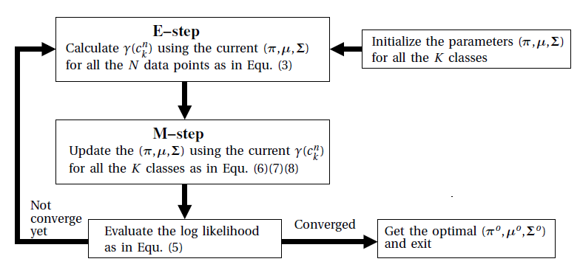
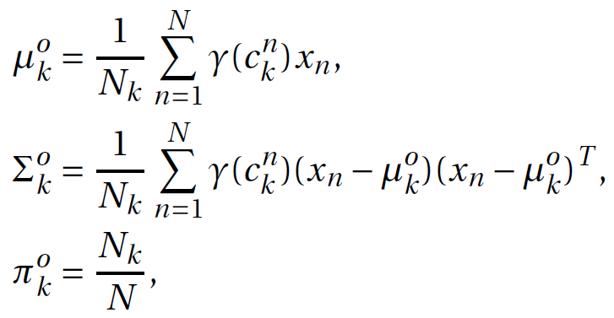
Our work – Expectation-Maximization (EM)
Likelihood
Maximum likelihood estimation
EM algorithm

Slide 15
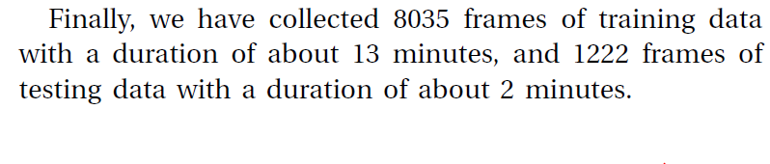
Our work – Dataset

Slide 16
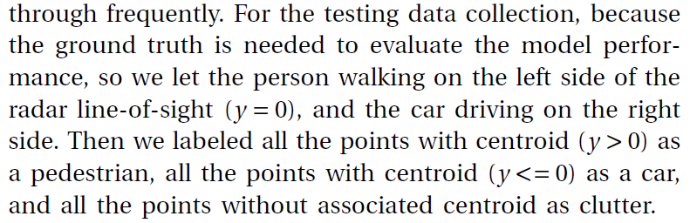
Our work – Ground Truth for Testing Data

Slide 17
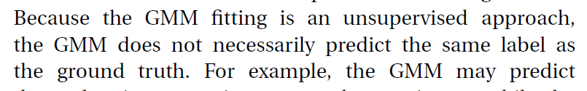
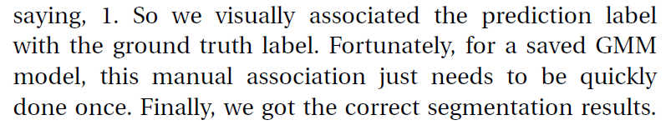
Our work – Prediction using GMM

Slide 18
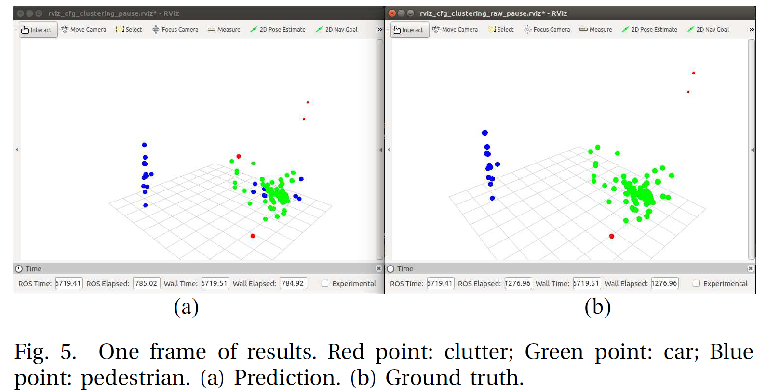
Our work – Results

Slide 19
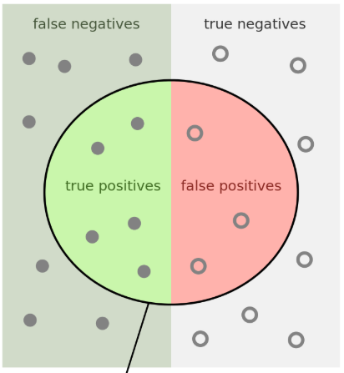
Our work – Results

Slide 20
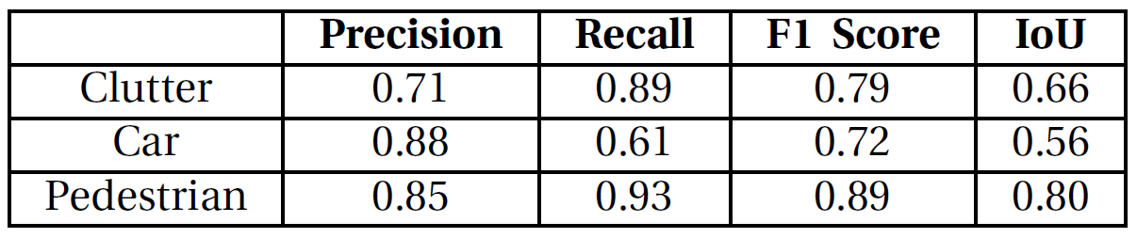
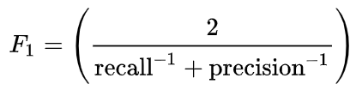
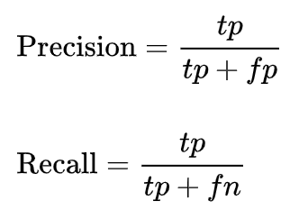
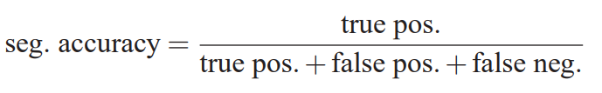
Our work – Results
The PASCAL Visual Object Classes (VOC) Challenge

Slide 21
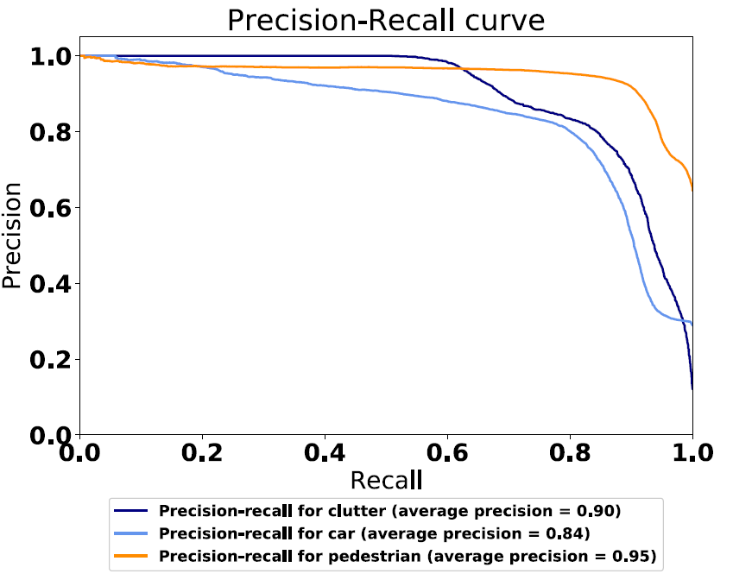
Our work – Results

Slide 22
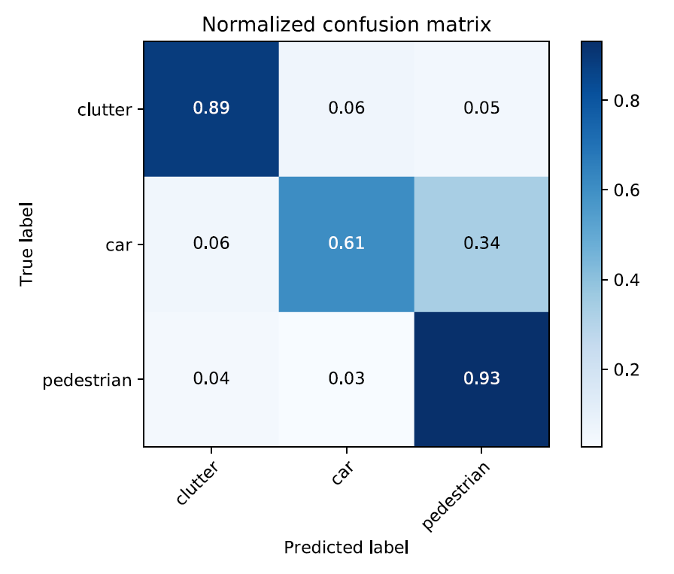
Our work – Results

Slide 23
Thanks! Q&A

